Slide 1
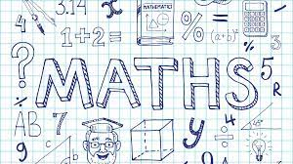
Brough Primary School
Maths workshop - Y3/4
Tuesday 7th November 2023

Slide 2
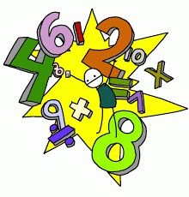
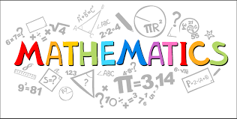
Session Aims
What does Maths look like in Year 3 and Year 4?
How can children be supported at home?

Slide 3
IN WHAT NUMBER PARKING SPOT IS THE RED CAR PARKED?
A question to get you thinking!
16 06 68 88 98
We want our children to become thinkers and collaborators.

Slide 4
IN WHAT NUMBER PARKING SPOT IS THE RED CAR PARKED?
The answer is …….. 87.
The number line is upside down.
16 06 68 88 98
We want our children to become thinkers and collaborators.

Slide 5
On a scale of one to ten, how much do you honestly enjoy Maths?

Slide 6
Research suggests that as many as 60% of adults would rather clean the toilet than work out a maths problem!
An even larger percentage say:
I was never any good at Maths.

Slide 7
A few facts as to why Maths is so important
Almost half of the working-age population of England have numeracy skills equivalent to those expected for an 11 year-old child.
Adults with poor numeracy skills are twice as likely to be unemployed than those who enjoy some competency in numeracy.
Those adults with at least basic numeracy skills can expect to earn a quarter more than those who lack the necessary skills to solve basic mathematical problems.

Slide 8
How is Maths taught at Brough Primary School?

Slide 9
CPA Approach: Concrete Pictorial Abstract
Concrete: 'doing' the maths- introducing real objects that can be manipulated to bring the problem to life. Eg: money, counters.
Pictorial: 'seeing the maths'- making connections between the concrete and the pictorial representations and the pictorial and the abstract. Eg: part whole models, bar models, ten frames.
Abstract: the ultimate goal is for children to understand abstract mathematical concepts, signs and notation. When a child demonstrates with concrete models and pictorial representations that they have grasped a concept, we can be confident that they are ready to explore the abstract.

Slide 10
Why is C-P-A so important?
In the past, children were taught procedures, but not why or how the procedure worked. In other words, children learnt the methods to get to an answer, without any understanding of the maths behind each method or procedure.
While there are children who are able to access the maths through just learning a procedure by rote, many others have great difficulty coping with the abstract nature of it.
Teaching methods without meaning leads to misconceptions, errors and difficulties in retaining the methods. Once children can actually ‘see’ the maths, they are much more likely to understand and accurately remember the methods.

Slide 11
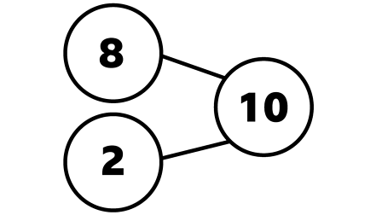
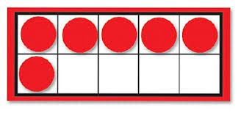
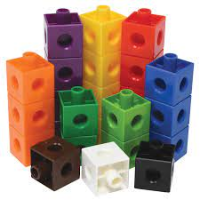
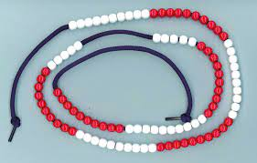
Manipulatives used in class to support learning
Part whole model
Bar model
Ten frames
Bead strings
cubes
Numicon

Slide 12
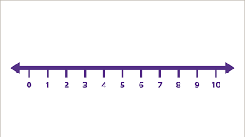
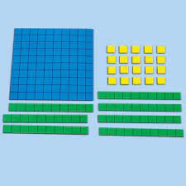
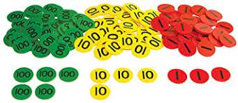
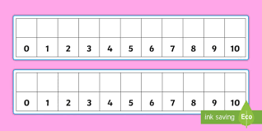
Number lines
Base 10
Number tracks
Place value counters

Slide 13
Fluency, reasoning and problem solving skills
What is problem solving?
Problem solving is applying the mathematics children have learnt to solve problems. If children are fluent in the mathematical procedures required for each topic, problem solving becomes much easier.
When approaching problems, children must first work out what the problem is asking them to do, before then applying their procedural knowledge to find a solution.
What is fluency?
Fluency starts with the ability to apply procedures accurately and efficiently. This means that children quickly become confident in the methods they will later need to use to solve more complex problems.
What is reasoning?
Reasoning enables children to make use of all their other mathematical skills; it could be described as the glue that helps mathematics make sense.
Reasoning is children understanding mathematics well enough that they can apply it to new situations and explain it.

Slide 14
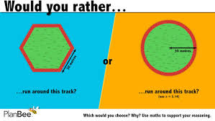
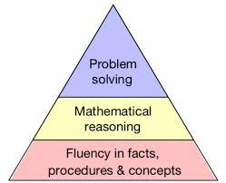
Progression in Reasoning

Slide 15
Using and applying maths skills in reasoning and problem solving questions.

Slide 16
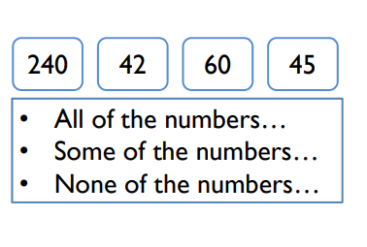
Have a go at this reasoning question

Slide 17
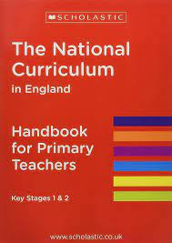
NATIONAL CURRICULUM AIMS FOR CHILDREN
What does Maths look like for children in Years 3 and 4?
National Curriculum Programmes of Study for Key Stage 1 and Key Stage 2

Slide 18
What does Maths look like in Year 3?
Consistently use the correct number formation (0-9).
To choose strategies to help me answer questions such as partitioning, number lines, counting on, counting back, bar models and eventually formal methods such as the column method.
To recognise the place value of each digit in a three-digit number (hundreds, tens and ones).
To read and write numbers up to 1,000
To understand the inverse relationship between add and subtract
To identify angles greater than or less than a right angle
To add and subtract mentally and scaling these by 10 e.g. 6 + 3 = 9, 60 + 30 = 90.
To solve number and practical problems, including reasoning using my number knowledge.
To recall my 2, 5, 10s, 3, 4 and 8 times tables and related division facts.

Slide 19
What does Maths look like in Year 4?
Find the perimeter of regular and irregular polygons.
Convert mixed numbers to improper fractions and vice versa.
Solve addition and subtraction two-step problems deciding which operations and methods to use and why
Begin to use expanded formal methods for addition and subtraction.
Have a secure understanding of number: confidently identifying the value of each digit in a 4 digit number E.g. 2378 the 3 represents 300.
Multiply two-digit and three-digit numbers by a one-digit number using formal written layout.
To confidently and securely know times tables facts, including the inverse up to 12x12
Recognise common groups of equivalent fractions and finding the corresponding decimal.
To solve practical and number problems using reasoning to justify answers.

Slide 20
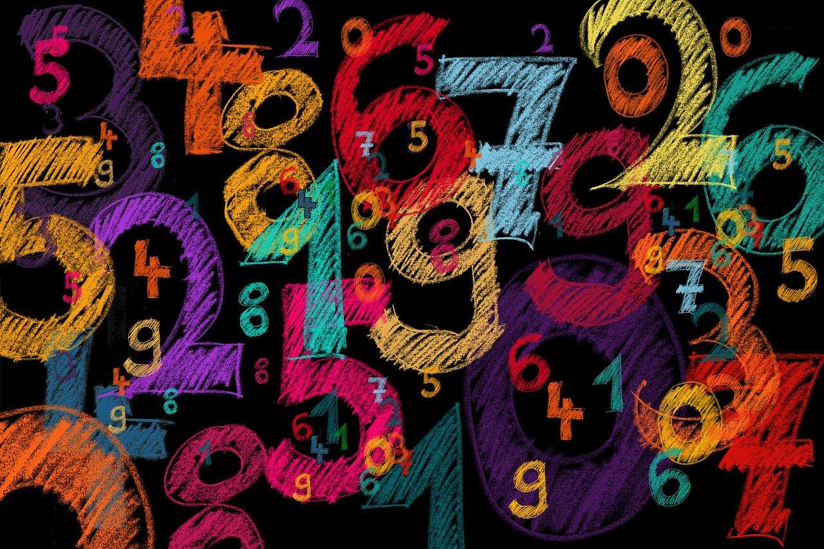
How can you help your child at home?

Slide 21
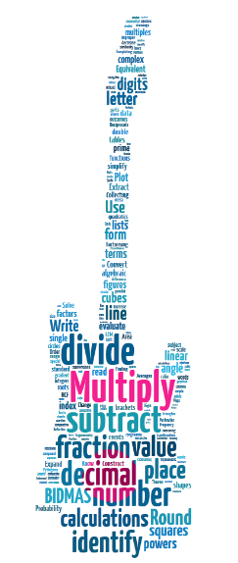
The times tables are the basics of maths. If you know the basics, you’ll find the rest much much easier.
@TTRockStars
ttrockstars.com
Notes:
T

Slide 22
All of the Maths concepts in the Maths cloud are taken from the GCSE curriculum and use times tables knowledge!
@TTRockStars
ttrockstars.com
Notes:
T

Slide 23
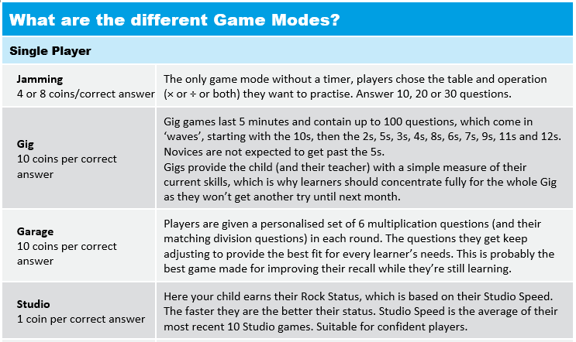
We recommend a “little and often” approach; 5 minutes practice a day, 4 or 5 times a week is a good target

Slide 24
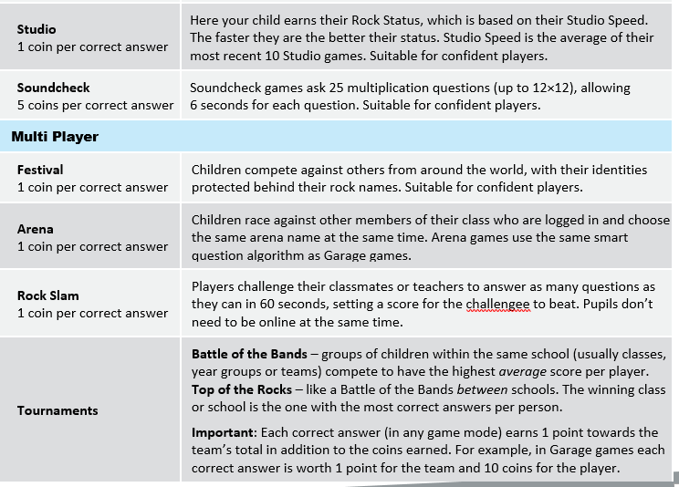
What are the different game modes?

Slide 25
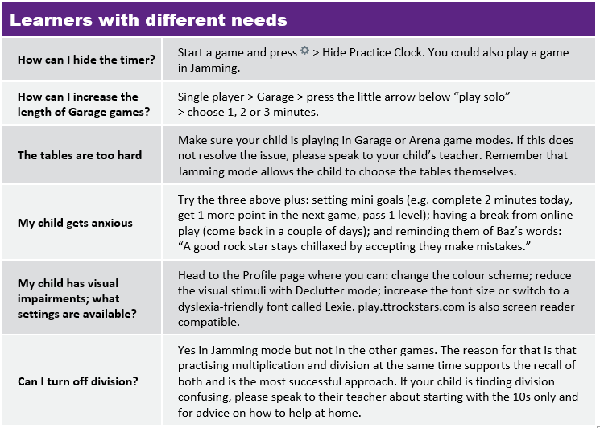
Times Table Rock Stars!

Slide 26
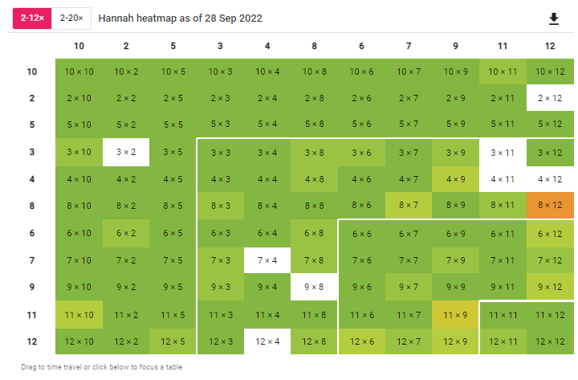
Checking your child’s progress
Checking your child’s progress is easy:
When your child has logged in, select their avatar in the top right hand corner and then select the ‘My Stats’ option.
In the effort tab, you can see how many minutes the children have played.
Under fluency, you can see how quickly your child is able to answer each question and how confident they are with their individual times table knowledge.
🡪
https://www.youtube.com/watch?v=phxP5_OhOtk

Slide 27
A quick guide to everyday Maths opportunities for your child
Practise spotting and recognising numbers in the environment. Add/multiply/subtract/divide door numbers, numbers on car registration plates, road signs and at the shop.
Flicking through the TV guide? Ask your child to calculate the length of their favourite programmes. How long is it until the next programme?
Use food packaging to discuss 2D and 3D shapes. What are the properties of these shapes e.g. how many faces, sides, vertices? Flatten the packaging out to find the net of the 3D shape too.
Measuring up for new furniture? Want to make sure the Christmas tree will fit in your living room? These are really good opportunities to encourage your child to see the value of careful measuring skills in everyday life.
Practise telling the time with your child. Can they read both the digital and analogue clock? Can they readily convert between the two and use the 24 hour clock? Can they also recognise Roman Numeral representations of the time too?
Board Games supply endless opportunities for Maths – Snakes and Ladders, Monopoly, Bingo, Connect Four, Battle Ships etc

Slide 28
Navigating our school website
We have a number of resources available for you to use with your children to support their Maths learning or to guide your own understanding of the Maths curriculum.
Key Areas covered:
curriculum statement.
long term plans.
Progression of skills.
parents information evening - calculator policies.
Ultimate Maths Vocabulary List.
Maths with Michael videos and fact sheets - place value, subtraction, multiplication, division, fractions, algebra.

Slide 29
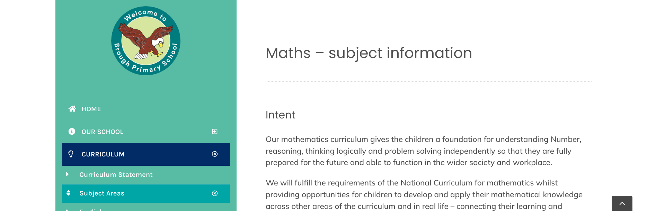
Navigating our school website
https://broughprimaryschool.co.uk/
curriculum - subject areas - Maths
Notes:
Maths dictionary for parents is really useful!

Slide 30
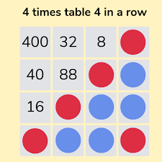
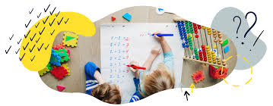
Children benefitting from learning in a sensory way
“What I hear, I forget;
What I see, I remember;
What I do, I understand.”
(Old Chinese proverb)

Slide 31
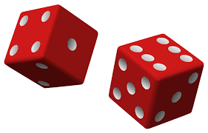
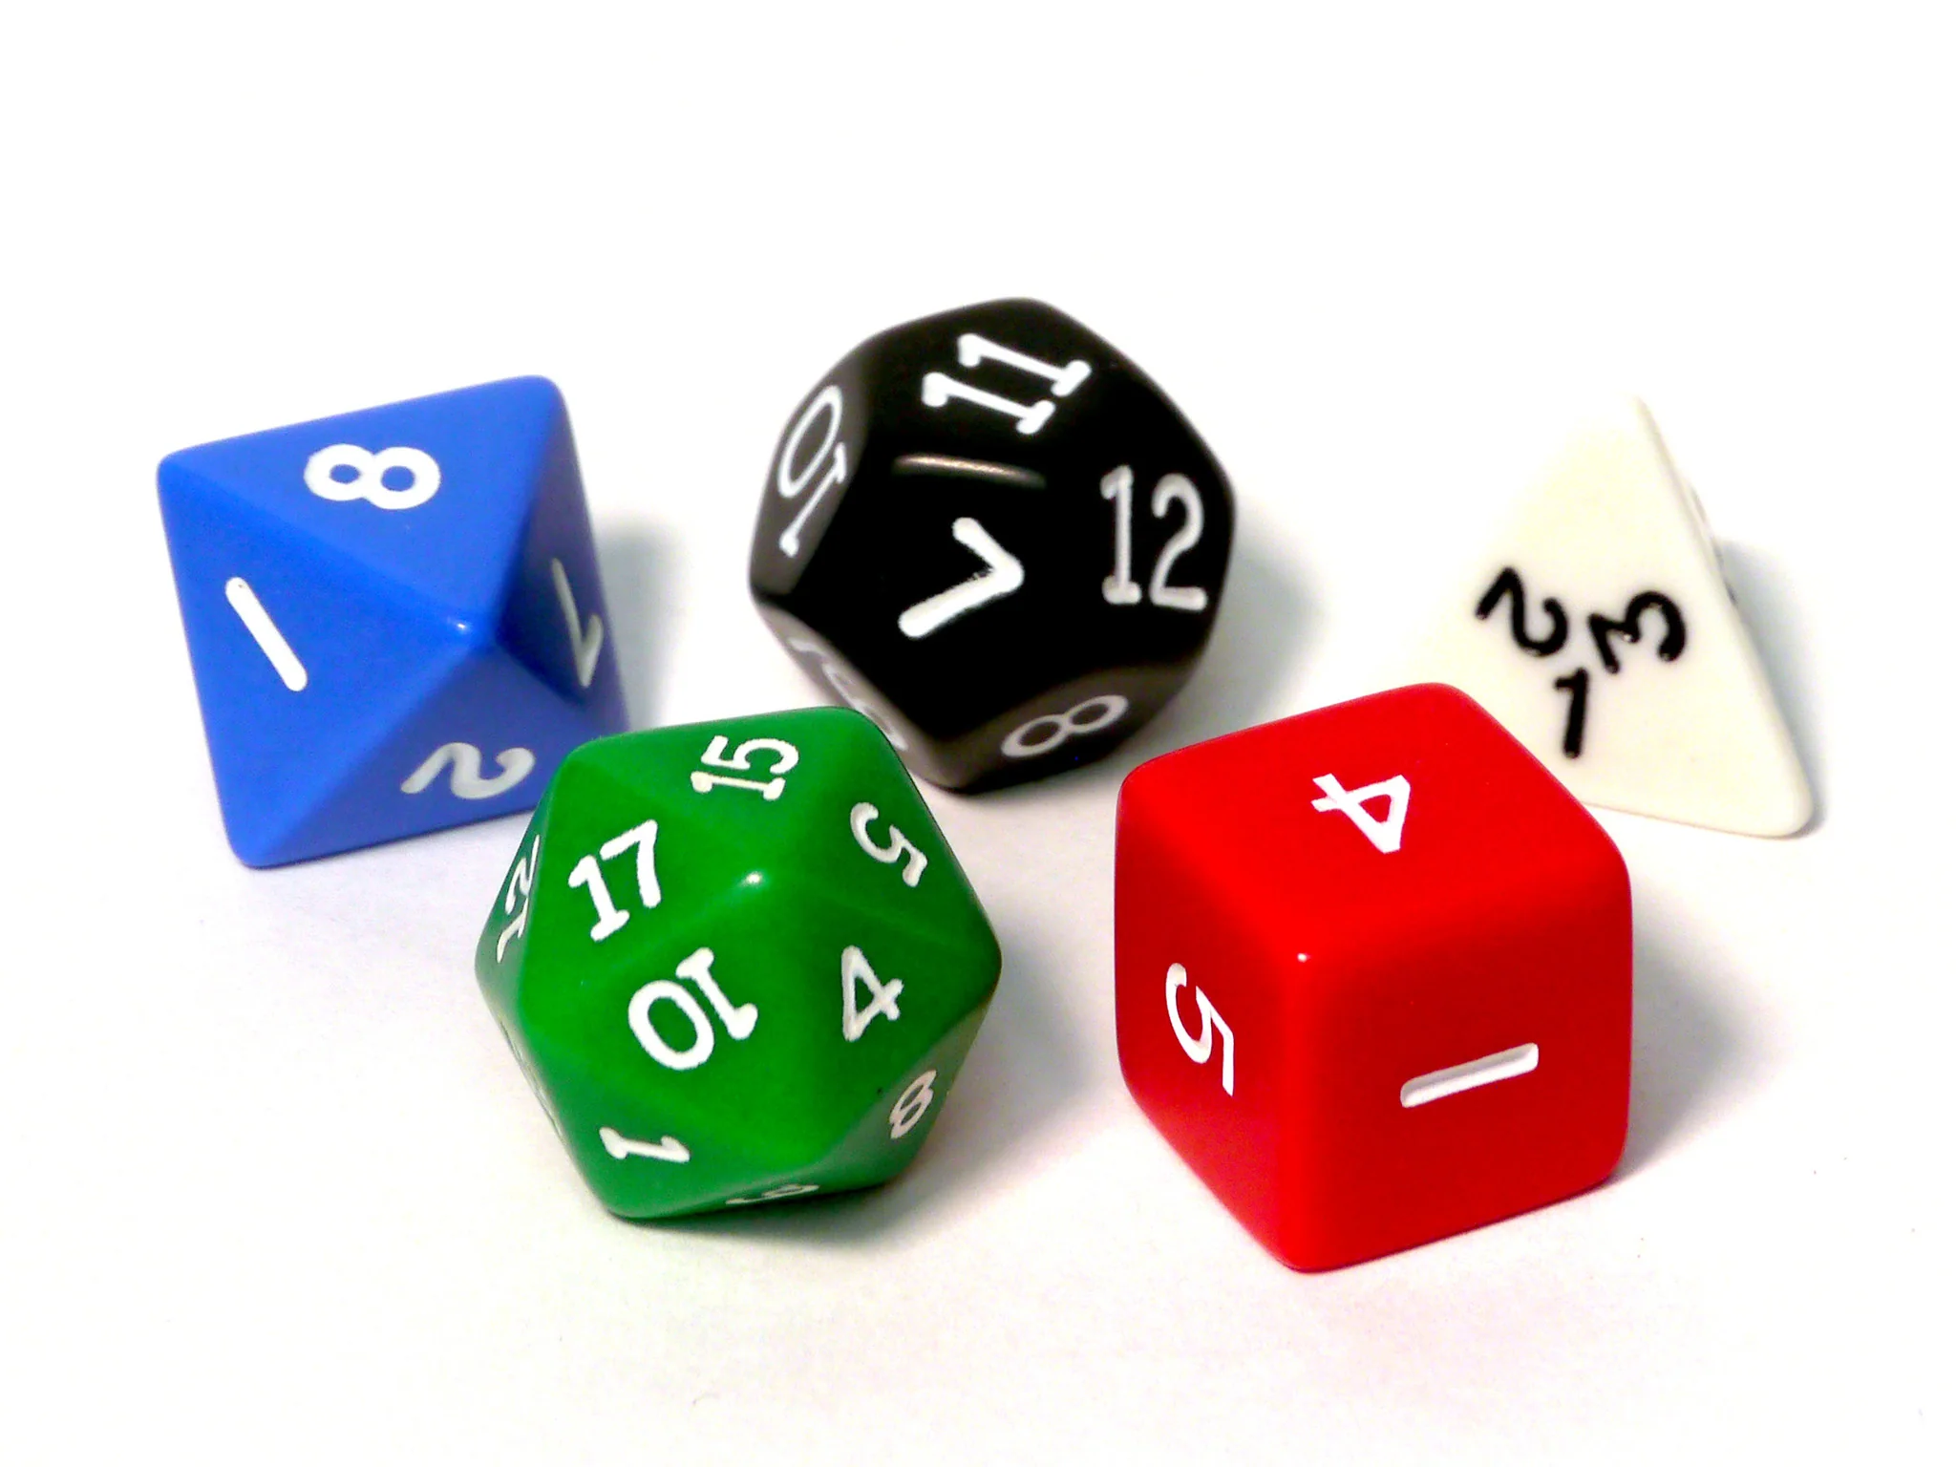
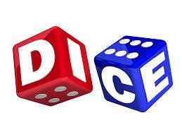
So let’s do……..
Some simple dice games:
Build it big.
Roll it and round
Improper fraction challenge
Area and perimeter

Slide 32
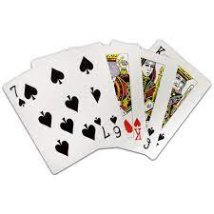
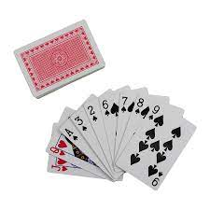
Some simple card games
Race to 100
Go Fish
Calculate loss or gain
Card turnover and multiply
Declare a fraction war
I spy

Slide 33
Websites to support children’s Maths skills
I See Maths – a useful site with a plethora of ideas for fun games that all the family
Primary Games - It is a free website that encourages children to play online maths games linked to their home learning. It breaks the games down into concepts which is really helpful.
Hit the Button – children love this game as it helps to increase confidence through practising times tables and number bonds.
Maths Zone – this site is jam-packed with fun ways to learn more about maths.
BBC Bitesize – lots of information alongside short videos help to make the learning enjoyable and accessible for all children.
Top Marks - a variety of Maths games linked to different aspects of Maths.

Slide 34
Build it big
You need to make dashes on your paper/whiteboard to indicate the place value of the number.
So, if you’re working on hundreds, make 3 dashes, 4 for thousands, and so on.
Take turns rolling dice the same number of times as the dashes. Each time a person rolls, he/she must think logically to place the number shown on the dice, on the dashes.
For example, if you are working on a large number and roll a six, it would go on the largest place value space but if you were working on making a small number, it would go on the smallest place value space.
Once you have placed a number, it can not be moved. The person with the highest (or lowest, depending upon the game’s goal) wins a point.
You could also use decimal points.
Roll and round
The first person rolls all three dice at the same time and builds a number with it.
The second person does the same and then each person rounds his/her number to the highest place value. For example, a roll of 5, 3, 7 could make the number 753, which would be rounded to 800.
Compare rounded numbers and the highest correctly rounded number wins .
You could also use decimal points, positive or negative numbers.

Slide 35
Improper fraction challenge
Each person rolls the 3 dice and makes an improper fraction by placing two of the dice side by side as the numerator and the other dice as the denominator, and then simplifies to make a whole number or a mixed number.
For example, if someone rolled 2, 4, 5…some possible fractions would be 24/5 = 4 4/5… or 54/2 = 27… or 45/2 = 22 1/2.
The higher-level thinking comes in as trying to make the largest number possible.
Area and perimeter
Each person rolls the dice and uses the numbers as the length and width of a rectangle.
Once area (or perimeter) has been determined, keep a running total of points. For example, if the area was ten and the second area was 6, the running total would be 16.
Highest score at the end wins.

Slide 36
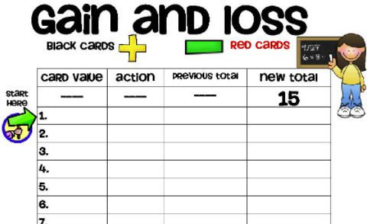
Some simple card games
Race to 100
Flip a card and add its value to your running total.
First person to reach 100 without going over wins!
(Remove face cards for younger players; use these values for older kids: Jack = 11, Queen = 12, King = 13, Ace = 0.)
Go fish
Go Fish, but in this version, you’re fishing for pairs that add up to 10.
Ask: “I have a 2. Do you have an 8 to make 10?”
Change aces to 1 for this game and leave face cards out entirely.
Calculate loss or gain
Each player starts with 15 points.
Player one flips a card (remove face cards or assign them point values first).
If the card is black, they add it to their total. If it’s red, they subtract it. Highest point total when all the cards are gone wins!

Slide 37
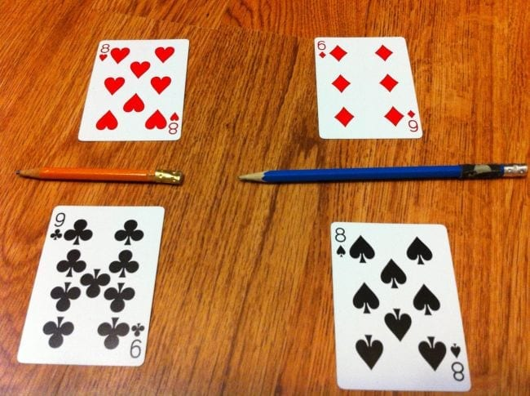
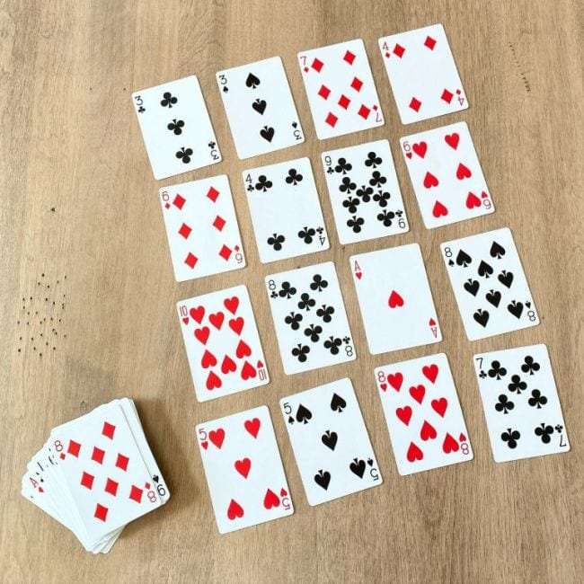
Card turnover and multiply
One person flips two cards from the deck.
The first person to multiply (or add, depending on what you want to practice) them correctly and call out the answer wins and takes both cards.
Play continues until all the cards are gone, and the winner is the one with the most cards.
Declare a fraction war
Deal two cards—a numerator and denominator—then determine whose fraction is the largest.
The winner keeps all four cards, and play continues until the cards are gone.
I spy
Lay out cards on the table, then take turns giving clues. “I spy two cards that add up to 12.”
Differentiate for younger children with options like, “I spy a card that’s less than 4,” or for older ones: “I spy two cards that are factors of 12.”

Slide 38
Thank you for coming.
Any questions?

